Slide 1
INSPIRING THE
NEXT GENERATION
FUTURUM
PODCAST
Electronics Engineering
with Professor Peter Gammon
futurumcareers.com

Slide 2
Pre-listening | Break the down | Post-listening | Learn more podcast
Pre-listening:
Meet
Professor Peter Gammon
What do you already know about electronics engineering?
When have you learnt about elements of electronics engineering, and what did you learn?
What do you think an electronics engineer does?
What skills and knowledge do you think this job requires?
What questions would you ask an electronics engineer about their career path?
How interested are you in pursuing a career in electronics engineering at the moment, and why?
Profile
Professor of Power Electronic Devices, University of Warwick, UK
FIELDS OF RESEARCH
Electronics Engineering, Electrical Engineering, Materials Science
“Learn to be resilient. You will have knocks along the way but always get back up, refocus and go again”

Slide 3
Pre-listening | Break the podcast down | Post-listening | Learn more
Break the podcast down:
Up to 03.00 minutes:
1. What is power electronics?
2. What type of research is Peter involved with?
3. In what way do power electronics play an important role in society moving to sustainable energy?
03.00 – 05:00:
4. What do you think are the benefits of doing an apprenticeship? Would you prefer to study A-levels or take on an apprenticeship? Why?
5. What do you think are the advantages of following the 'halfway house' path?

Slide 4
Pre-listening | Break the podcast down | Post-listening | Learn more
Break the podcast down:
05:00 – 06:45:
6. Have there been times in your own education when you have 'changed paths'? Why, and how did you find this experience?
7. What is the appeal of following an academic route at university? Which elements of the university experience appeal to you?
8. Which English skills do you think are needed to write reports? What experience of reading and writing reports have you had? How could you develop these skills?
9. How confident are you in physics, chemistry and maths? Where do your strengths lie in these subjects? Which skills do you need to focus on for these subjects? Who could you talk to for support or guidance in this area?
10. Regardless of career paths or long-term goals, what do you enjoy doing and learning about?

Slide 5
Pre-listening | Break the podcast down | Post-listening | Learn more
Break the podcast down:
06:45 – 9:00:
11. To what extent do you agree with Peter about how and where we learn to 'work'? What do you feel you need to learn that academia cannot teach you? What experiences do you think you need to be a successful, focused individual?
12. Which of these examples - making semi-conductors, writing programs and designing car power systems - appeals to you the most and why? What do you already know about these areas? For example, what have you learnt about semi-conductors?
13. Why do you think Peter describes diversity in engineering as essential? Why do you think the field needs and is all the better for a diverse range of engineers working in it?
9:00 – end:
14. Have you played with a Raspberry PI? If so, what did you do? If not, which teacher could you talk to about how to access one?

Slide 6
Pre-listening | Break the podcast down | Post-listening | Learn more
Post-listening:
How would you describe what an electronics engineer does to someone who has not listened to Peter’s podcast?
Which skills and knowledge does electronics engineering require?
To what extent do you have these skills? Which skills do you need to develop further?
What did Peter say that you had not expected him to say?
What have you learnt about being an electronics engineer that you did not know before?
Which piece of advice did you find most useful and why?
What further questions would you ask Peter about electronics engineering and/or his career?*
Now that you have heard Peter talk, how interested are you in electronics engineering, and why?
*Submit questions to Peter here.

Slide 7
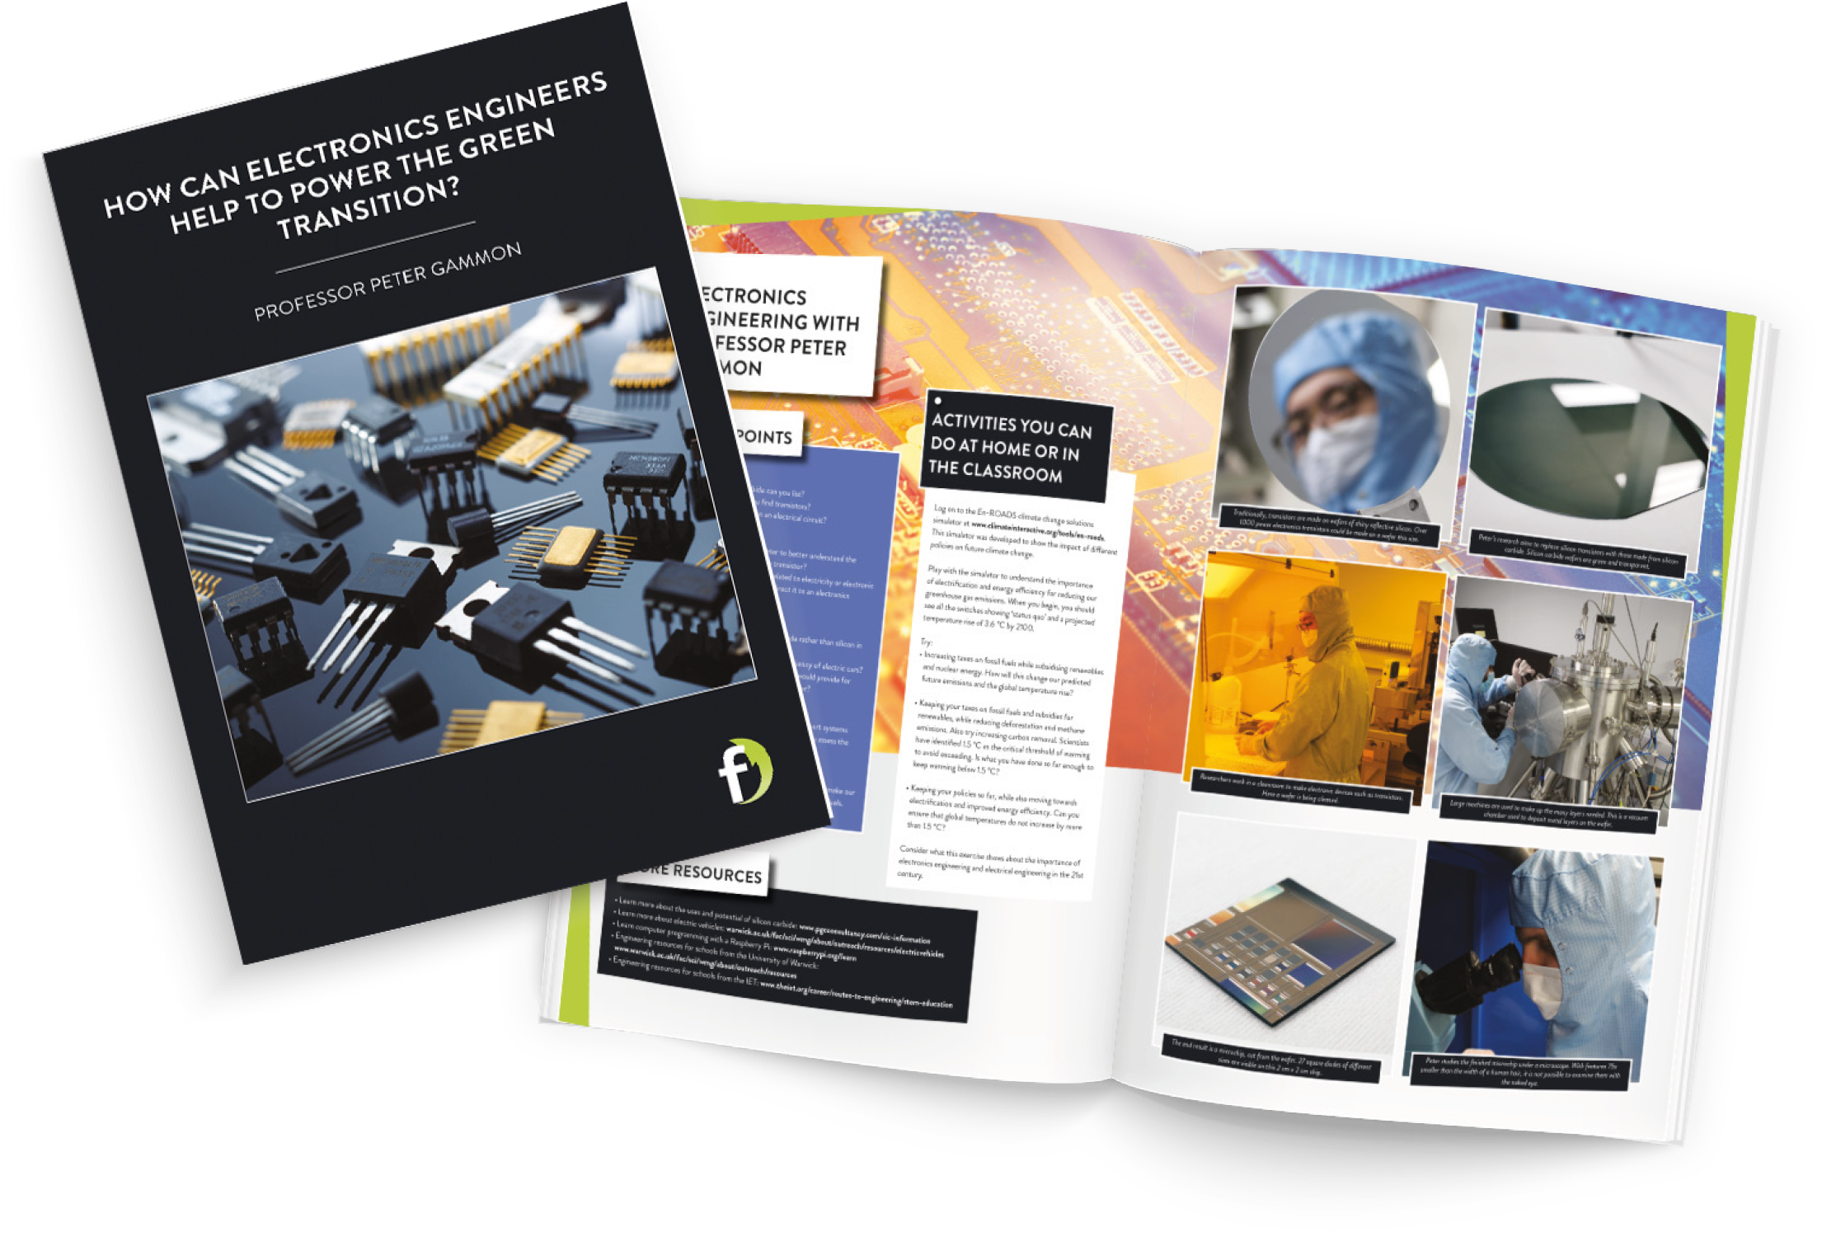
Pre-listening | Break the podcast down | Post-listening | Learn more
Learn more about Peter’s work:
Read the article here.
Watch the animation here.
INSPIRING THE
NEXT GENERATION
futurumcareers.com

